Slide 1
Evaluating youth employment policies with administrative data: methodological and practical challenges
Judit Krekó
Youth employment partnerSHIP: evaluation studies in Spain, Hungary, Italy and Poland
Conference of the Czech Evaluation Society
9 June 2021
Judit Krekó
Budapest Institute for Policy Analysis

Slide 2
Background: Youth employment partnerSHIP
Research project in international cooperation:
Evaluation studies in Spain, Hungary, Italy and Poland
Counterfactual impact evalution of active labour market policy programmes
Motivation: high share of young persons, who are Not in Education, Employment or Training (NEETs)
Research products: http://yepartnership.ibs.org.pl/publications
Hungarian evaluation:
Can a short-term job trial programme kick-start young jobseekers’ career?
http://yepartnership.ibs.org.pl/p/can-a-short-term-job-trial-programme-kick-start-young-jobseekers-career
Counterfactual evaluation of youth employment policies - Methodological guide
http://yepartnership.ibs.org.pl/content/uploads/2021/02/Methodological-guide.pdf

Slide 3
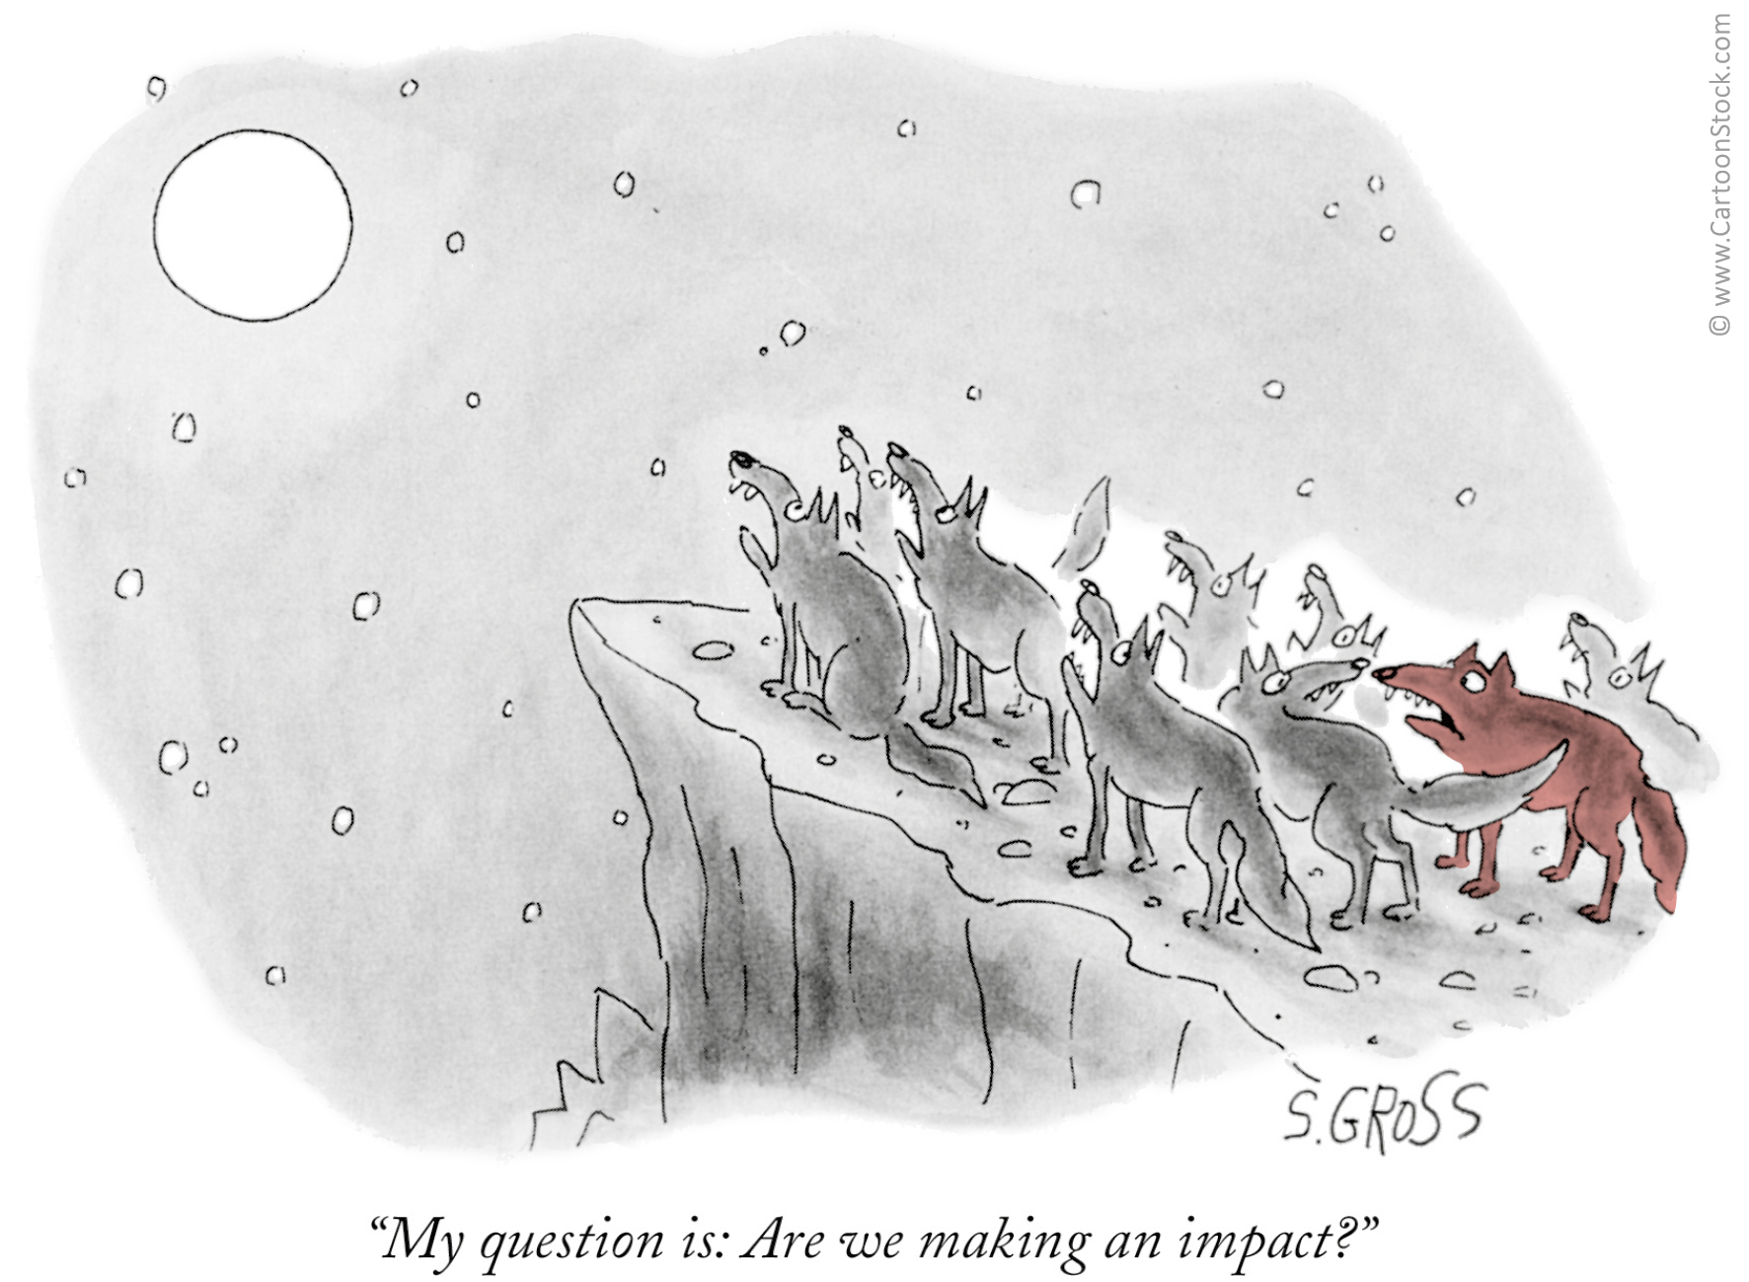
COUNTERFACTUAL EVALUATION OF YOUTH EMPLOYMENT POLICIES - METHODOLOGICAL GUIDE
Tips and experiences from the evaluation of labor market programs aiming at young people in Poland, Spain, Italy and Hungary
Main issues covered:
Use of and access to administrative data
The process of the evaluation:
  How to choose a specific programme to evaluate?
  Choice of the outcome variable
    What are the goals of the programme?
  Choice of the counterfactual evaluation method
  Heterogenous effects
Presentation and interpretation of the results for policymakers
  Conclusions for design and implementation, external validity,
  deadweight losses, cost efficiency

Slide 4
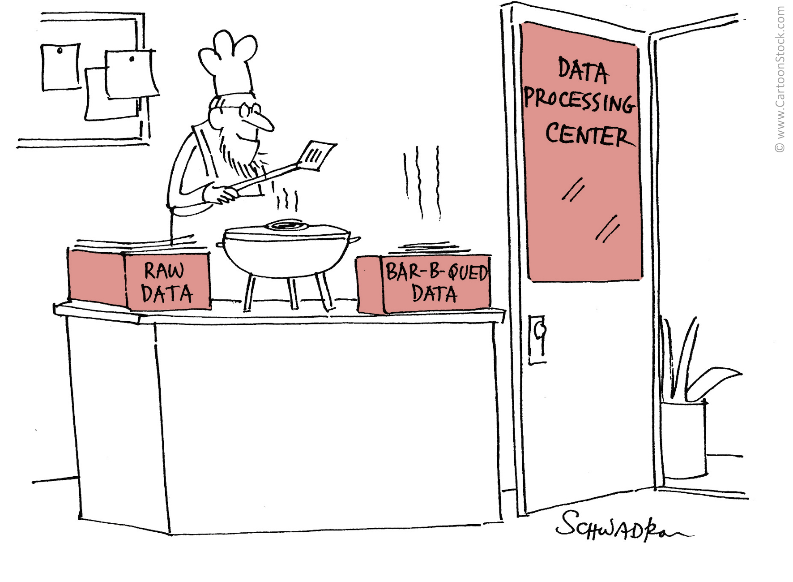
THE USE OF ADMINISTRATIVE DATA
The beauty of administrative data:
High or full coverage, large sample sizes
Usually high reliability and completeness
Bias from self-reporting is less of an issue
Potential of link different databases
Administrative data sources for labour market analysis:
Social security (Pension, health autorities)
Public employment services (PES)
Unemployment registries
Tax authority database (Personal oand corporate income)
Emloyer databases

Slide 5
MAIN CHALLENGES WITH ADMINISTRATIVE DATA
Main challenges:
Legal or practical obstacles to accessing and linking datasets
  Is there a formal procedure for obtaining access to admin data or is it
  discretionary?
  Data protection considerations vs bureaucratic barriers
Does a country level database exist?
Can we identify the programme participants, or only the eligible group?
Does the database contain the necessary variables?
  Pool of background variables might be limited (family status, education)
  Labour programme participants are often not followed up: hard to get outcome variables
  ↓
  Linking different administrative databases might be a solution
  (e.g. PES with social security, linked employer-employee databases)
Actual evaluation
strategy
Ideal evaluation framework
Data constraints

Slide 6
COUNTERFACTUAL EVALUATION OF YOUTH EMPLOYMENT POLICIES - METHODOLOGICAL GUIDE
Tips and experiences from the evaluation of labor market programs aiming at young people in Poland, Spain, Italy and Hungary
Main issues covered:
Use of and access to administrative data
The process of the evaluation:
  How to choose a specific programme to evaluate?
  Choice of the outcome variable
    What are the goals of the programme?
  Choice of the counterfactual evaluation method
  Heterogenous effects
Presentation and interpretation of the results for policymakers
  Conclusions for design and implementation, external validity,
  deadweight losses, cost efficiency

Slide 7
COUNTERFACTUAL IMPACT EVALUATION
Main problem: the counterfactual world is not observed
↓
The evaluatior has to infer from actual data
But: non-participants might differ from participants in observed and unobserved characteristics
↓
Selection bias:
Baseline difference: the outcome of the two groups are different even without the policy
Heterogeus policy effect: the policy affects participants and non-participants differently

Slide 8
HOW TO CHOOSE AN IDENTIFICATION STRATEGY?
Is allocation into the pogramme random(ised)?
YES
NO
Apply randomized control trial
Apply a quasi-experimental framework
Is there a rich set of controls to eliminate the selection bias?
NO, or weak variation
Is there strong enough exogenous variation in the program set-up?
Pool of eligible applicants is restricted (e.g. age)
Timing of introduction varies
YES
NO
YES
Matching, OLS, control function
Try and find better data
Regression discontinuity, diff-in-diff, IV
Treatment group
Control group
Treatment group
Control group
Programme participants
Eligible non-participants
Eligible population or groups with higher probability of treatment
Non-eligible, similar groups or smaller probability of treatment

Slide 9
AN APPLICATION: COUNTERFACTUAL EVALUATION OF THE 90-DAY JOB TRIAL PROGRAMME IN HUNGARY
90-day job trial
One of the various programmes within Youth Guarantee of EU, introduced in 2015
Short term wage subsidy, up to 100% of total labour costs
Subsidized period: 90 days, no obligation of further employment →cheap, but might kick-start employment by a good introduction
Main questions:
Q1 Who are selected into the program from the pool of registered jobseekers?
  Principle of Youth Guarantee: priority to long-term unemployed, vulnerable and socially excluded groups
Q2 What is the effect of participation in the job trial program on
  Work: probability of being employed 6 months after the program and cumulative days within 6 months after completing the programme
  Wages: cumulative wages within 6 months after completing the program

Slide 10
IDENTIFICATION STRATEGY AND DATA
Identification is a challenge:
Hard to find exogenous variation and a good control group
Hard to separate the job trial from other Youth Guarantee programmes (same eligibility rules, same time)
↓
Propensity score matching program participants using two control groups
  Participants of public works program (and have not participated in YG)
  Participants of training programs
How can we remove the selection bias?

Slide 11
PROPENSITY SCORE MATCHING
Basic idea: compare programme
participants with similar non-participants
Similar: has the same chance to
participate in the programme
(has similar propensity score)

Slide 12
DATA, OUTCOME AND CONTROL VARIABLES
Data: Admin3
a large database consists of linked datasets of administrative authorities:
tax, social secutiry, health, public employment service, educational authority
Individual level, random 50% sample of the population
Data on program details, employment, wages, benefits from 2003
↓
Rich set of:
Control variables: full labour market history, education background, health status, benefits and transfers, competence test scores, type of settlement, distance to public employment service etc.
Outcome variables: employment status and wage income after completion of the programme

Slide 13
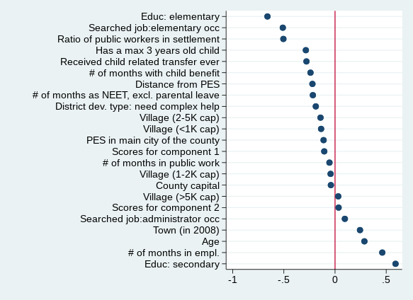
SELECTION INTO THE TREATMENT GROUP: CREAM SKIMMING
Job trial (and YG) participants are the most
employable registered jobseekers
  More educated
  Longer employment history, shorter NEET history
  Shorter maternity history
  Lower prob. to live in small villages
  Lower prob. to search elementary jobs
Contradicts principle of YG:
priority should be given to most vulnerable groups
and long term unemployed

Slide 14
OTHER RESULTS
Participation in job trial increases the probability of working 6 months after the programme compared to public works participants significantly by 6-8% points
    Selection accounts for more than half of the raw mean difference in the probability of being employed between the treatment group and public works participants
But no significant difference compared to training participants
Higher educated programme participants have better outcomes 6 months after the programme, but compared to the control group, the impact is similar on participants with basic education
→Higher priority should be given to disadvantaged youth
Gender dimension: mothers are less likely to participate, the participant women are even more selected than males and the policy effect is weaker → Policy should foster participation of young mothers

Slide 15
Thank you for your attention!
Budapest Institute for Policy Analysis
info@budapestistitute.eu

