Slide 1
Can a short-term job trial programme kick-start young jobseekers’ career?
COUNTERFACTUAL EVALUATION OF THE 90-DAY JOB TRIAL PROGRAMME IN HUNGARY
Judit Krekó, Márton Csillag, Balázs Munkácsy and Ágota Scharle
Youth employment partnerSHIP: evaluation studies in Spain, Hungary, Italy and Poland
Lost Millenials project kickoff
2021 November 17
Centre for Economic and Regional Research
Budapest Institute for Policy Analysis
Márton Csillag

Slide 2
BACKGROUND: HUNGARIAN CONTEXT
Hungarian context:
Young unemployment is not especially high,
But high NEET is an issue, especially for women

Slide 3
90-DAY JOB TRIAL
Part of the Hungarian Youth Guarantee (from 2015)
Short term wage subsidy, up to 100% of total labour costs
No obligation of further employment
Literature is scarce on similar programmes
  Note: ‘typical’ wage subsidy lasts for 9-12 months, covers 70-100% of total labour costs, but comes with the obligation of continued employment (for and additional 4.5-6 months)

Slide 4
90-DAY JOB TRIAL: Pros and Cons
PROS
relatively inexpensive as a programme
provides work experience
low risk for both parties
helps overcoming stereotypes and information assymetry
CONS
disposable, short-term, cheap labor for firms OR
firms might mainly acquire it for people they would have hired anyway (~deadweight loss)

Slide 5
RESEARCH QUESTIONS
Q1 Who are selected into the program?
  from the pool of registered jobseekers
  priority to long-term unemployed, vulnerable and socially excluded groups (in principle)
Q2 What is the effect of participation in the job trial program on…
  Employment:
    Probability of being employed 6 and 12 months after the program
    Number of days spent in work within 6 and 12 months after completing the programme
  Wages: cumulative wages within 6 and 12 months after completing the program

Slide 6
IDENTIFICATION STRATEGY
Propensity score matching (kernel based) using two control groups
  Participants of public works program (and have not participated in YG)
  Participants of training programs
  Main idea: find individuals, who, based on their background characteristics, have a similar probability to participate in the programme
    Hinges having sufficiently rich data about determinants of programme participation & outcomes
    But cannot deal with selection based on ‘unobservable characteristics’ (motivation, network etc.)
The evaluation covers the 2015-2017 period

Slide 7
DATA: ADMIN3
monthly panel of 50% of all individuals in Hungary
linked datasets of administrative authorities:
  Tax
  Social secutiry
  Health authority
  Public employment service (NFSZ)
  Educational authority
Data on program details, employment, wages, benefits for 2009-2017
Created and owned by the Databank of the Centre of Regional and Economic Studies

Slide 8
VARIABLES
Control variables:
  full labour market history
  education
  health status
  benefits and transfer history
  competence test scores
  development-level and type of settlement
  distance of home address to public employment service
  regional share of public workers, registered unemployed, and roma
  occupation codes
Outcome variables: employment status and income after completion of the programme

Slide 9
TREATMENT AND CONTROL GROUPS
Treated:
90-days wage subsidy
Start bw January 2015 - March 2017
Except if who combined with further wage subsidies following the 90 days → selection issues
(subsequent wage subsidy was not allowed in 4 counties → robustness check)
Control 1:
Registered jobseekers (under 25), enrolled in public work after 2015 January 1
Control 2:
Registered jobseekers (under 25), enrolled in any training programme, but not receiving wage subsidy

Slide 10
SELECTION INTO THE TREATMENT GROUP: CREAM SKIMMING
Job trial (and YG) participants are the most employable registered jobseekers
  More educated
  Longer employment history, shorter NEET history
  Shorter maternity history
  Lower prob. to live in small villages
  Lower prob. to search elementary jobs
Not consistent with the principles of Youth Guarantee:
  priority should be given to most vulnerable groups and long term unemployed

Slide 11
PSM MATCHING: OUTCOMES ON 6 MONTHS HORIZON
Notes:
Job trial increases probability of being employed 6 months after the programme and cumulative days significantly compared to public works
Smaller difference compared to training programmes, significant only in cumulative days
Significant effect on cumulative wage to minimum wage, but only if exclude public work wages (compared to pw)
→ job trial improves employment prospects, but does not ensure signifiantly higher wages than public work

Slide 12
INCENTIVE TO SELECT MORE EDUCATED JOBSEEKERS INTO THE PROGRAMME
Notes:
Raw employment probability 6 months after the programme is an important monitoring indicator of Youth Guarantee programmes
It is higher for better educated participants
However, impact (ATT) is comparable for lower and higher educated → different indicators by level of education might help

Slide 13
MATCHING RESULTS: 6 vs. 12 MONTHS: THE IMPACT DIMINISHES WITH TIME
Notes:
Table shows estimates of average treatment effects on the treated. The underlying matching algorithm is Epanechnikov kernel propensity score matching combined with exact matching on gender and level of education, with replacement. Bandwidth is calculated with a pair-matching based algorithm following the proposal of Huber et al. (2015). Standard errors in parentheses.* p < 0.1, ** p < 0.05, *** p < 0.01

Slide 14
DOES JOB TRIAL PROMOTE LONG TERM WORK RELATIONS?
Job trial for short term, seasonal work
  Firms in accommodation and food services are more likely to participate in YG than other firms
  Participants are more likely to work in commercial and catering occupations than other 20-25 year-olds (24 vs 15%)
Some firms misuse the subsidy:
  of those who stay at the same workplace where received the subsidy, 12% work as a temporary worker and 8% as a public worker
  Of those who employed after the programme, 40% works at the same firm where received the subsidy 6 months, 30% 12 months after the programme (67% if including subsequent 8+4 month wage subsidy)

Slide 15
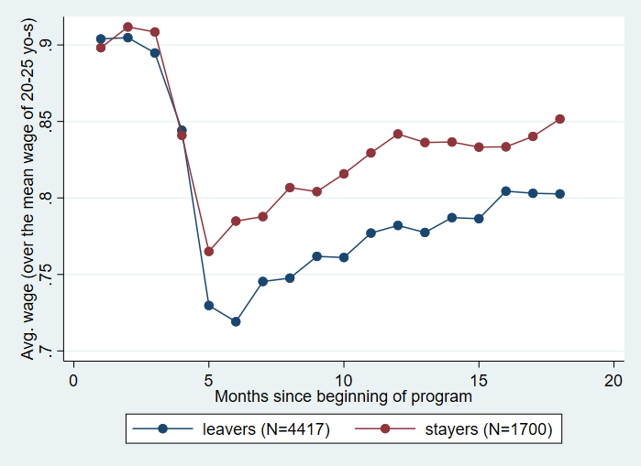
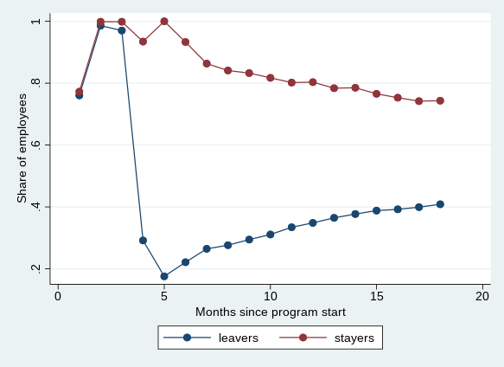
PARTICIPANTS STAYING AT THE FIRM HAVE BETTER OUTCOMES
Wage/average wage of 20-25 years old Employment rate

Slide 16
CONCLUSIONS
Clear sign of „cream skimming”: the programme does not reach those who need the help the most
Participation in job trial improves labour market outcomes 6 months after the programme compared to public works participants significantly , smaller difference compared to training participants
  The impact weakens on the 12 months horizon
A potential explanation for cream skimming: better educated have better outcomes, but the impact of the programme is similar to lower educated

Slide 17
Thank you for your attention!
Budapest Institute for Policy Analysis
Imarton.csillag@budapestistitute.eu

