Slide 1
Increasing the Effectiveness of Youth Employment Policies
Csillag Márton
Budapest Institute
Impact of ALMP for Youth

Slide 2
Main policy issues in EU
Youth Guarantee is to provide a fitting offer for all young persons
However, effectiveness is often linked to finding tailor-made solutions
The Bridge to Jobs emphasizes the distinction between temporary and long-term NEETS
Hence we need to evaluate the impact of programmes:
What do we know about which type of “active” program works?
Short-run vs. long-run effects?
Do ALMPs work better for some groups? In some places or times?
We also need to study the actual assignment to programmes

Slide 3
The Role of the Youth Guarantee
The YG has helped more than 36million NEETs (2014-2019) and around 15 billion EUR have been invested through the YEI and the ESF
we know relatively little: meta-analysis of ESF CIE in preparation
Main categories of ALMPs: Job search assistance; Training; Hiring incentives; Direct job creation on secondary LM (public works)
There are differences in the issues faced across the EU:
In some countries/for some groups the main issue is that youth are not (formally) employed, and are stuck in NEET status
in others, youth are stuck in temporary contracts, bad jobs

Slide 4
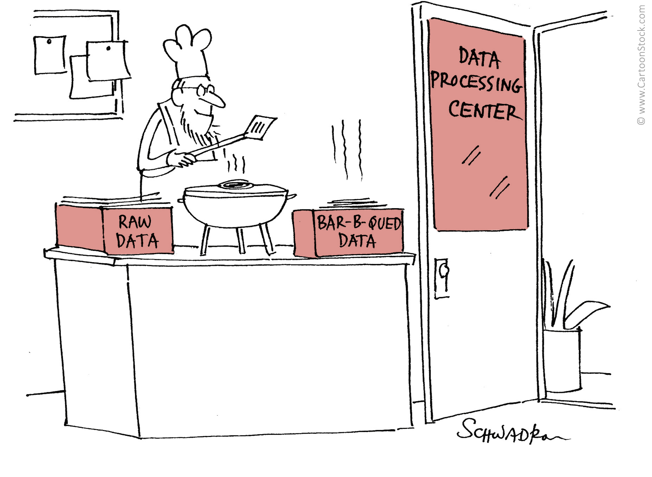
The promises of using administrative data
The advantage of administrative data:
High or full coverage, large sample sizes
Often long time horizons, usually high reliability
Relatively low costs of obtaining
Potential of link different databases
Administrative data sources for labour market analysis:
Social security (Pension, health authorities)
Public employment services
Tax authority database (Personal and corporate income)
Employer databases

Slide 5
Counterfactual impact evaluation
Main problem: the counterfactual world is not observed -> The evaluator has to infer from actual data
But: non-participants might differ from participants in observed and unobserved characteristics
↓
Selection bias:
Baseline difference: the outcome of the two groups are different even without the policy
Heterogenous policy effect: the policy affects participants and non-participants differently
See ‘Counterfactual evaluation of Youth Employment Policies’ – this project
See ‘Counterfactual impact evaluation of European Social Fund interventions in practice’, DG EMPL

Slide 6
Issues with evaluating the Youth Guarantee
Can individual programmes within the YG be evaluated or it needs to be as a package?
Depends on the context, in some countries, programmes in YG not very complex
In principle, clear age cutoff (under 25 vs over 25)
In practice hard to separate from other similar ALMPs available for older unemployed persons
Can good control groups be found from within the same (YG eligible) age-group?
Typically, same eligibility rules for all programmes
Participation depends on the choice of the young person or the PES counsellor
Those who do not participate in an ALMP are (typically) a very heterogeneous group
Well-educated young persons who can find a job on their own
Those facing multiple disadvantages, and potentially with low motivation to find a job

Slide 7
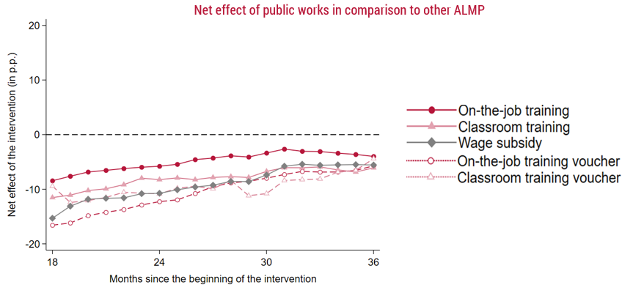
Comprehensive evaluation of different ALMPs in Poland
Evaluation of the relative effects of different ALMPs, not relative to the absence of participation
Public works participation is not beneficial and it is particularly disadvantageous for those with low education, and those in high unemployment regions
In some cases, training vouchers are more effective than assignment by PES counsellors, for on-the-job training
However, over a longer horizon, around 2.5 years after programme entry, effects tend to fade out

Slide 8
A job trial programme in Hungary
Short term wage subsidy (90 days), up to 100% of total labour costs, no obligation of further employment
the job trial is widely used
Evaluation shows that, relative to participation in public works (the largest alternative) the job trial is beneficial:
More days worked and higher earnings on the primary labour market
Effects tend to fade out with time
However,
Only 40% (30%) of youth work at the same firm 6 (12) months after the programme
10% work as a temporary worker and 5% as a public worker at the same firm
Some indication of using job trial for short term, seasonal work: overrepresentation in accommodation and foods services sectors

Slide 9
A cautionary tale on targeting the YG
Job trial (and YG) participants are the most employable registered jobseekers
More educated; Longer employment history, Shorter maternity history
Not consistent with principles of the Youth Guarantee: priority should be given to most vulnerable groups and long term unemployed
Estimation shows that positive impact is similar for lower and higher educated, but higher educated participate. Why?
Main monitoring indicator of YG: employment 6 months after the programme (raw outcome, not impact)
PES have no incentive to ‘push’ vulnerable youth

Slide 10
Employment policies in dual labour markets
IT: Social security cost rebates, the employers’ expectation of reduced firing costs of (regular) employees
Effect on share of workforce hired with open-ended contracts is stronger for young individuals
ES: the internship contract – long-term reduction in social security payments (and lower wages) to incentivise investment into training and promote job stability
Evaluation reveals that interns have a lower probability of obtaining an indefinite contract at the same firm than those on a regular temporary contract
Firms use the internship to prolong the period of temporary contracts
Youth typically obtain an indefinite contract if the move to a different firm

Slide 11
Conclusions
Administrative data become relatively widely available for researchers
Counterfactual evaluations of YG with admin data are possible, but information on implementation details are important
Evaluations show that often the type of young persons who end up in certain ALMPs are actually the ones who benefit from them less
Problem of outreach: more vulnerable NEETs do not registers as jobseekers -> have a lower chance of getting an ALMP
especially important in the case of young women
Net impact estimates are markedly different from raw outcomes
Follow-up monitoring indicators of YG that take into account level of education/vulnerability could be a first step

