Slide 1
Can a short-term job trial programme kick-start young jobseekers’ career?
COUNTERFACTUAL EVALUATION OF THE 90-DAY JOB TRIAL PROGRAMME IN HUNGARY
Judit Krekó, Márton Csillag, Balázs Munkácsy and Ágota Scharle
Youth employment partnerSHIP: evaluation studies in Spain, Hungary, Italy and Poland
SEAM CONFERENCE
02-03 Septermber 2021
Márton Csillag
Budapest Institute for Policy Analysis

Slide 2
BACKGROUND AND MOTIVATION
The Youth Guarantee is a commitment by all Member States to ensure that all young people under the age of 25 years receive
a good quality offer of employment, or continued education, or apprenticeship, or traineeship
within a short period (4 months) of becoming unemployed or leaving formal education
Priority: long-term unemployed, vulnerable and socially excluded groups
Supported by EU financial sources
Hungarian context:
Young unemployment is not especially high,
But high NEET rate is an issue,
  especially for women

Slide 3
90-DAY JOB TRIAL
One of the various programmes within Youth Guarantee, introduced in 2015
Short term wage subsidy, up to 100% of total labour costs,
Subsidized period: 90 days, no obligation of further employment
This was one of the most ‘popular’ programmes, 40% of all wage subsidies, 25% of all YG programmes
Few papers on Youth Guarantee (e.g. Bratti et al, 2018) and literature on job trials is scarce

Slide 4
90-DAY JOB TRIAL
Cheaper than longer wage subsidies, but provides:
Gain of real work experience
No need for longer term commitment by either party → lower risk
Work experience increases the value of the CV
Helps in overcoming negative stereotypes and reducing informational asymmetries
Potential risks:
Firms may regard this program as a short-term cheap labour → integration is not considered
Deadweight losses

Slide 5
QUESTION, IDENTIFICATION STRATEGY
Q1 Who are selected into the program from the pool of registered jobseekers?
  Principle of Youth Guarantee: priority to long-term unemployed, vulnerable and socially excluded groups
Q2 What is the effect of participation in the job trial program on
  Work: probability of being employed 6 and 12 months after the program and cumulative days within 6 and 12 months after completing the programme
  Wages: cumulative wages within 6 and 12 months after completing the program
Identification strategy: Propensity score matching (kernel based) using two control groups
Exact matching on gender and education

Slide 6
DATA, OUTCOME AND CONTROL VARIABLES
Data: Admin3
a large monthly panel database consists of linked datasets of administrative authorities: Tax; social security; health authority; public employment service (PES); educational authority
Individual level, random 50% sample of the population
Data on program details, employment, wages, benefits from 2003
Created and owned by the Databank of the Centre of Regional and Economic Studies
↓
Rich set of:
Control variables: full labour market history, education background, health status, benefits and transfers, competence test scores, type of settlement, distance to public employment service, etc.
Outcome variables: employment status and wage income after completion of the programme

Slide 7
TREATMENT AND CONTROL GROUPS
Treated:
Participants of wage subsidy, with length of 90 days, started between January 2015 - March 2017
Excluding participants who combine 90 day programme with a 8+4 month 70% wage subsidy (this combination is allowed in YG) → selection issues
→ estimate only on 4 counties, where subsequent wage subsidy was not allowed as a robustness check
Control 1:
Registered jobseekers, who enrolled into public work after 2015 January 1, but have not entered into YG, below 25 years
Control 2:
Registered jobseekers, enrolled into any training programme, but have not participated in any other wage subsidy programme, below 25 years

Slide 8
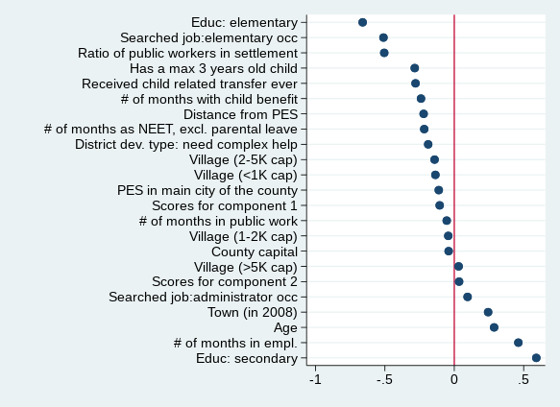
SELECTION INTO THE TREATMENT GROUP: CREAM SKIMMING
Job trial (and YG) participants are the most
employable registered jobseekers
  More educated
  Longer employment history, shorter NEET history
  Shorter maternity history
  Lower prob. to live in small villages
  Lower prob. to search elementary jobs
Contradicts principle of Youth Guarantee:
priority should be given to most vulnerable groups
and long term unemployed
Standardized mean difference between job trial participants and eligible jobseekers

Slide 9
PSM MATCHING: OUTCOMES ON 6 MONTHS HORIZON
Job trial increases probability of being employed 6 months after the programme and cumulative days significantly compared to public works
Smaller difference compared to training programmes, only in cumulative days
No significant effect on cumulative wage to minimum wage, only if exclude public work wages (compared to pw)
→ job trial improves employment prospects, but does not ensure significantly higher wages than public work

Slide 10
INCENTIVE TO SELECT MORE EDUCATED JOBSEEKERS INTO THE PROGRAMME
Raw employment probability 6 months after the programme is an important monitoring indicator of Youth Guarantee programmes
It is higher for better educated participants, however
However, ATT is comparable for lower and higher educated → different indicators by level of education might help

Slide 11
MATCHING RESULTS: 6 vs. 12 MONTHS: THE IMPACT DIMINISHES WITH TIME
Table shows estimates of average treatment effects on the treated. The underlying matching algorithm is Epanechnikov kernel propensity score matching combined with exact matching on gender and level of education, with replacement. Bandwidth is calculated with a pair-matching based algorithm following the proposal of Huber et al. (2015). Standard errors in parentheses.* p < 0.1, ** p < 0.05, *** p < 0.01

Slide 12
DOES JOB TRIAL PROMOTE LONG-TERM WORK RELATIONS?
Indication of using job trial for short term, seasonal work
  Industry breakdown: accommodation and food services have higher share in firms employing job trial participants than all firms
Some firms misuse the subsidy:
  of those who stay at the same workplace where received the subsidy, 12% work as a temporary worker and 8% as a public worker
Not many firms retain young persons, only 1/3 of work at the same firm immediately after the programme, and only 20% one year later
  the wages of retained workers is much higher than for leavers (no subsidy)

Slide 13
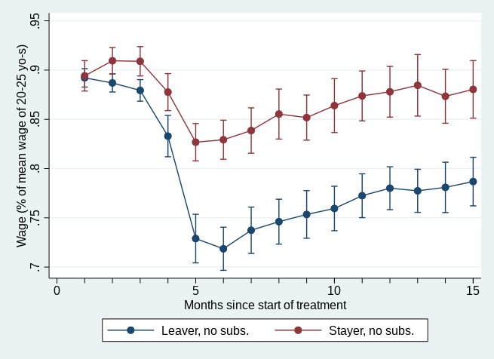
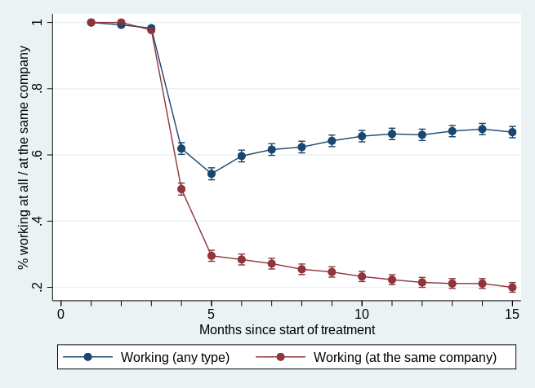
PARTICIPANTS STAYING AT THE FIRM HAVE BETTER OUTCOMES
Wage/average wage of 20-25 years old Employment rate

Slide 14
CONCLUSIONS
Clear sign of „cream skimming”: the programme does not help reach those who need the help the most
Participation in job trial increases the probability of working 6 months after the programme compared to public works participants significantly (ATT),
But no significant difference compared to training participants
A potential explanation for cream skimming: better educated have better outcomes
However, the impact of the programme is similar to lower educated
Positive effect on cumulative wages excluding public work, but zero or negative including pw..
The impact diminishes with time

Slide 15
Thank you for your attention!
Budapest Institute for Policy Analysis
info@budapestistitute.eu

