Slide 1
Can a short-term job trial programme kick-start young jobseekers’ career?
COUNTERFACTUAL EVALUATION OF THE 90-DAY JOB TRIAL PROGRAMME IN HUNGARY
Judit Krekó, Márton Csillag, Balázs Munkácsy and Ágota Scharle
Youth employment partnerSHIP: evaluation studies in Spain, Hungary, Italy and Poland
Szirák
2021 November 6
Centre for Economic and Regional Research
Budapest Institute for Policy Analysis
Judit Krekó

Slide 2
BACKGROUND AND MOTIVATION
The Youth Guarantee is a commitment by all Member States to ensure that all young people under the age of 25 years receive
a good quality offer of employment, or continued education, or apprenticeship, or traineeship
within a short period ( 4 months) of becoming unemployed or leaving formal education
Priority: long-term unemployed, vulnerable and socially excluded groups
Supported by EU financial sources:
  Young Employment Initiative, European Social Fund
  8,8 billion EUR for 2014-2020
Hungarian context:
Young unemployment is not especially high,
But high NEET rate is an issue, especially for women
NEET: Not in Education, Employment or Training

Slide 3
90-DAY JOB TRIAL
One of the various programmes within Youth Guarantee, introduced in 2015
Short term wage subsidy, up to 100% of total labour costs,
Subsidized period: 90 days, no obligation of further employment
Under 25 years of age
Few papers on Youth Guarantee (e.g. Bratti et al, 2018) and literature on job trials is scarce
Cheaper than longer wage subsidies, but provides:
Gain of real work experience
No need for longer term commitment by either party →lower risk
Work experience increases the value of the CV
Helps in overcoming negative stereotypes and reducing informational asymmetries
Potential risks:
Firms may regard this program as a short-term cheap labour → integration is not considered
Deadweight losses

Slide 4
QUESTION, IDENTIFICATION STRATEGY
Q1 Who are selected into the program from the pool of registered jobseekers?
  Principle of Youth Guarantee: priority to long-term unemployed, vulnerable and socially excluded groups
Q2 What is the effect of participation in the job trial program on
  Work: probability of being employed 6 and 12 months after the program and cumulative days within 6 and 12 months after completing the programme
  Wages: cumulative wages within 6 and 12 months after completing the program
Identification strategy: Propensity score matching (kernel based) using two control groups
  Participants of public works program (and have not participated in YG)
  Participants of training programs
The evaluation covers the 2015-2017 period

Slide 5
DATA, OUTCOME AND CONTROL VARIABLES
Data: Admin3
a large monthly panel database consists of linked datasets of administrative authorities:
  Tax, social secutiry, health authority, public employment service (NFSZ) educational authority
  Individual level, random 50% sample of the population
  Data on program details, employment, wages, benefits from 2003
  Created and owned by the Databank of the Centre of Regional and Economic Studies
↓
Rich set of:
Control variables: full labour market history, education background, health status, benefits and transfer history, competence test scores, type of settlement, distance of home address to public employment servicepublic workers/ registered unemployed, roma share of population,
Outcome variables: employment status and wage income after completion of the programme

Slide 6
DATA, OUTCOME AND CONTROL VARIABLES
Data: Admin3
a large monthly panel database consists of linked datasets of administrative authorities:
  Tax, social secutiry, health authority, public employment service (NFSZ) educational authority
  Individual level, random 50% sample of the population
  Data on program details, employment, wages, benefits from 2003
  Created and owned by the Databank of the Centre of Regional and Economic Studies
↓
Rich set of:
Control variables: full labour market history, education background, health status, benefits and transfer history, competence test scores, type of settlement, distance of home address to public employment servicepublic workers/ registered unemployed, roma share of population,
Outcome variables: employment status and wage income after completion of the programme

Slide 7
PARTICIPANTS OF YOUTH GUARANTEE AND PUBLIC WORKS
Table: number of participants in YG and PW programmes by type of settlement, in 2015-2017
 | Youth Guarantee |  | YG 90 day job trial |  | Public work
settlement type | Freq. | Percent | Freq. | Percent | Freq. | Percent
Bp and county seats | 5828 | 16.8 | 1446 | 15.5 | 2505 | 8.8
town in 2008 | 13751 | 39.7 | 4060 | 43.6 | 9358 | 32.8
village, above 10 th | 14 | 0.0 | 7 | 0.1 | 7 | 0.0
village, 5-10 th | 717 | 2.1 | 217 | 2.3 | 692 | 2.4
village, 2-5 th | 5553 | 16.0 | 1429 | 15.3 | 5325 | 18.7
village, 1-2 th | 4705 | 13.6 | 1116 | 12.0 | 5113 | 17.9
village, below 1 th | 4055 | 11.7 | 1045 | 11.2 | 5558 | 19.5
 | 34623 |  | 9320 |  | 28558

Slide 8
CONTROL VARIABLES
Education
Labour market history:
  Employment, unemployment, NEET, public work, parental transfer history
Geographical
  Type of settlement, development of the district, public employment service at the county seat, share of public workers in the settlement, distance of the settlement from the public employment service
Healthcare expenditures
Compared to public workers: occupation code (FEOR)
Competence test scores (available to a subsample)

Slide 9
TREATMENT AND CONTROL GROUPS
Treated:
Participants of wage subsidy, with length of 90 days, started between January 2015 - March 2017
Excluding participants who combine 90 day programme with a 8+4 month 70% wage subsidy (this combination is allowed in YG) →selection issues
→ estimate only on 4 counties, where subsequent wage subsidy was not allowed as a robustness check
Control 1:
Registered jobseekers, who enrolled into public work after 2015 January 1, but have not entered into YG, below 25 years
Control 2:
Registered jobseekers, enrolled into any training programme, but have not participated in any other wage subsidy programme, below 25 years
9

Slide 10
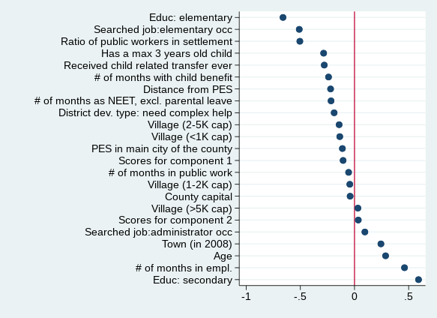
SELECTION INTO THE TREATMENT GROUP: CREAM SKIMMING
Job trial (and YG) participants are the most
employable registered jobseekers
  More educated
  Longer employment history, shorter NEET history
  Shorter maternity history
  Lower prob. to live in small villages
  Lower prob. to search elementary jobs
Contradicts principle of Youth Guarantee:
priority should be given to most vulnerable groups
and long term unemployed
Standardized mean difference between job trial participants and eligible jobseekers

Slide 11
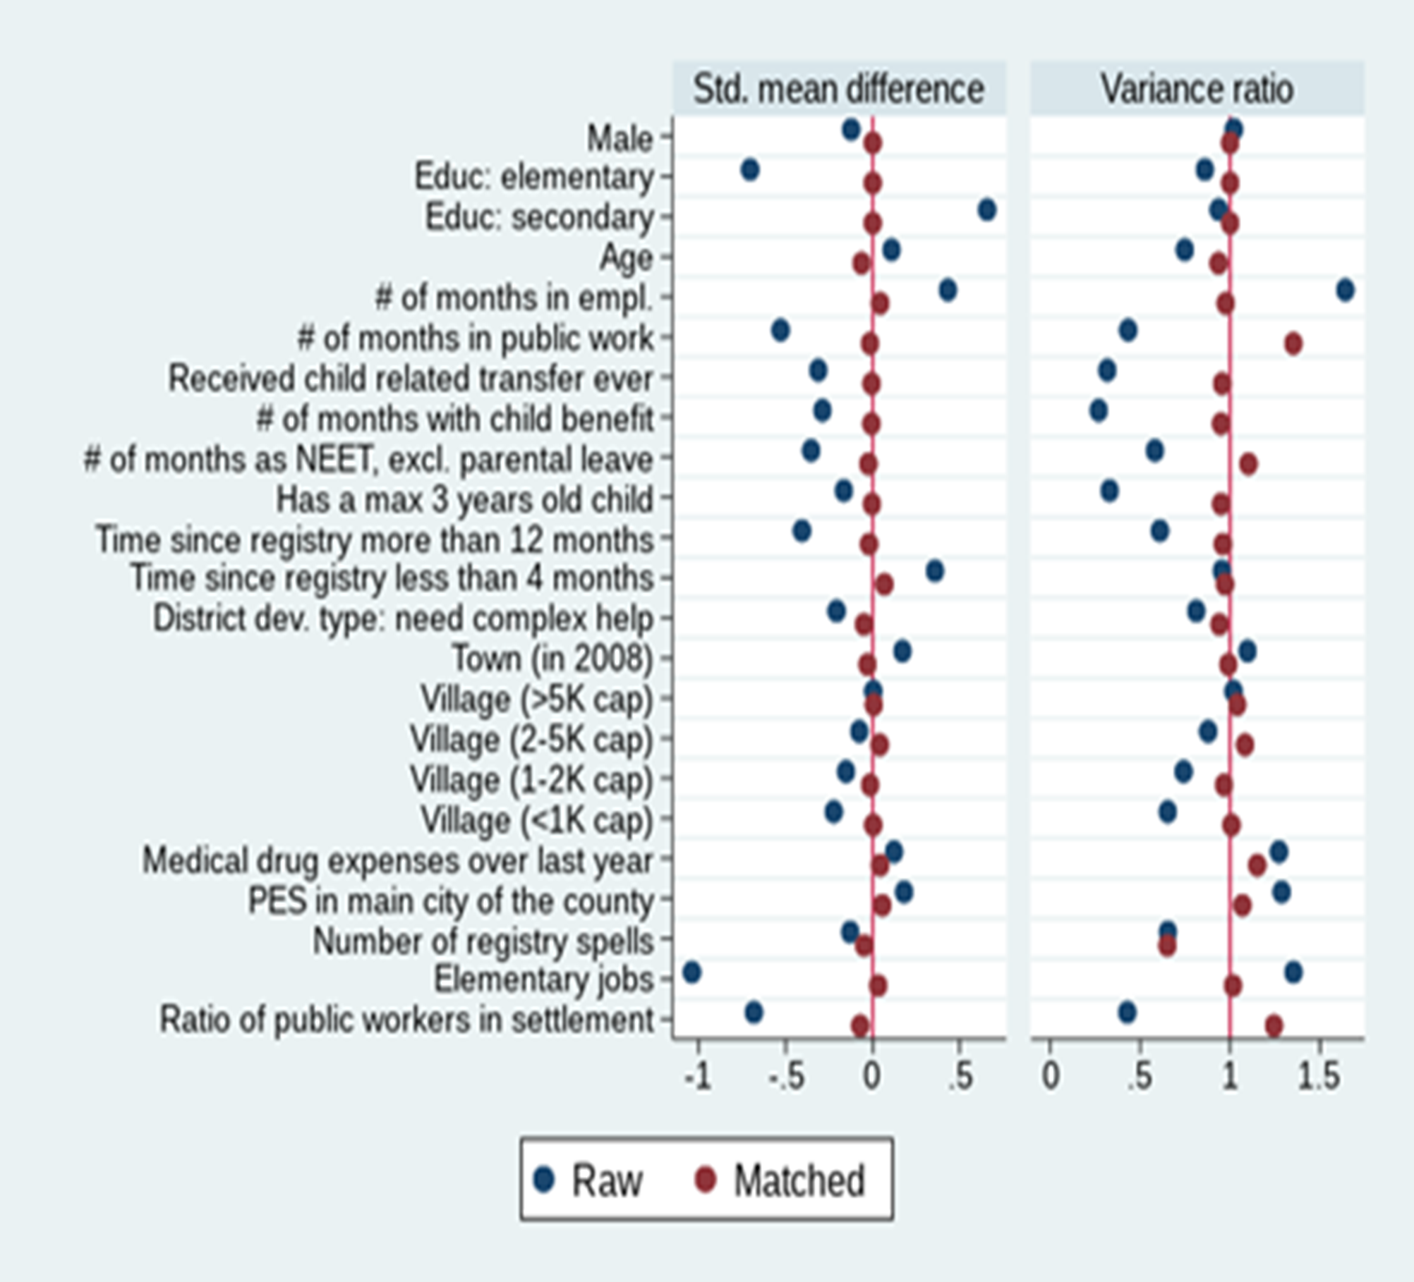
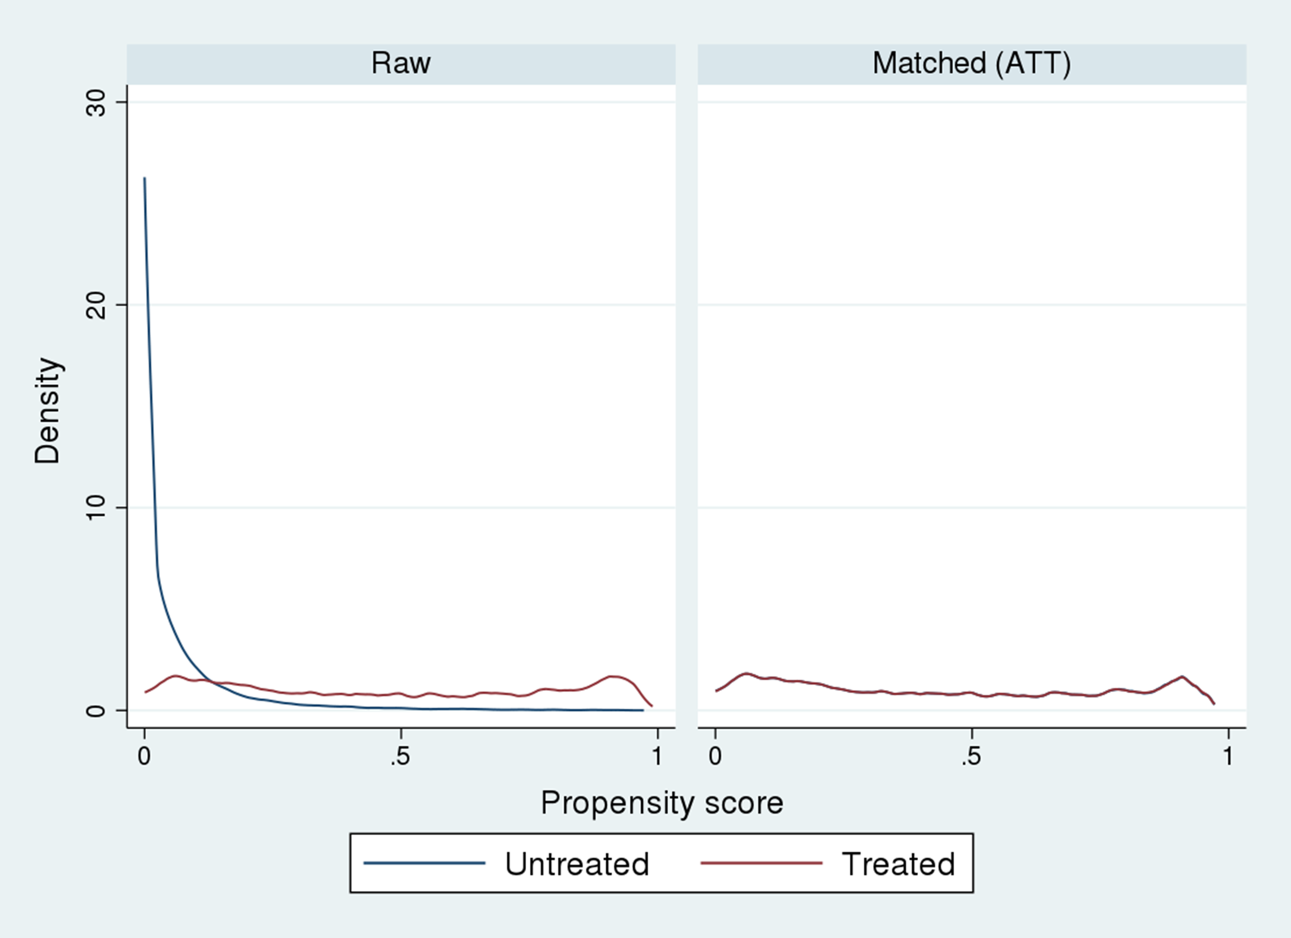
MATCHING DETAILS AND BALANCE (CONTROL GROUP: PUBLIC WORKS
Distribution of propensity score- control:pubic work
Kernel based matching, exact matching on education and gender
Imposing common support

Slide 12
PSM MATCHING: OUTCOMES ON 6 MONTHS HORIZON
Job trial increases probability of being employed 6 months after the programme and cumulative days significantly compared to public works
Smaller difference compared to training programmes, significant only in cumulative days
Significant effect on cumulative wage to minimum wage, but only if exclude public work wages (compared to pw)
→ job trial improves employment prospects, but does not ensure signifiantly higher wages than public work

Slide 13
INCENTIVE TO SELECT MORE EDUCATED JOBSEEKERS INTO THE PROGRAMME
Raw employment probability 6 months after the programme is an important monitoring indicator of Youth Guarantee programmes
It is higher for better educated participants
However, impact (ATT) is comparable for lower and higher educated → different indicators by level of education might help

Slide 14
MATCHING RESULTS: 6 vs. 12 MONTHS: THE IMPACT DIMINISHES WITH TIME
Table shows estimates of average treatment effects on the treated. The underlying matching algorithm is Epanechnikov kernel propensity score matching combined with exact matching on gender and level of education, with replacement. Bandwidth is calculated with a pair-matching based algorithm following the proposal of Huber et al. (2015). Standard errors in parentheses.* p < 0.1, ** p < 0.05, *** p < 0.01

Slide 15
DOES JOB TRIAL PROMOTE LONG TERM WORK RELATIONS?
Indication of using job trial for short term, seasonal work
  Industry breakdown: accommodation and food services have higher share in firms employing job trial participants than all firms (15 vs 5%)
  Job breakdown: commercial and catering occupations have higher share in job trial participants than
  all 20-25 years old employed (24 vs 15%)
Some firms misuse the subsidy:
  of those who stay at the same workplace where received the subsidy, 12% work as a temporary worker and 8% as a public worker
Of those who employed after the programme, 40% works at the same firm where received the subsidy 6 months, 30% 12 months after the programme (67% if including subsequent 8+4 month wage subsidy)

Slide 16
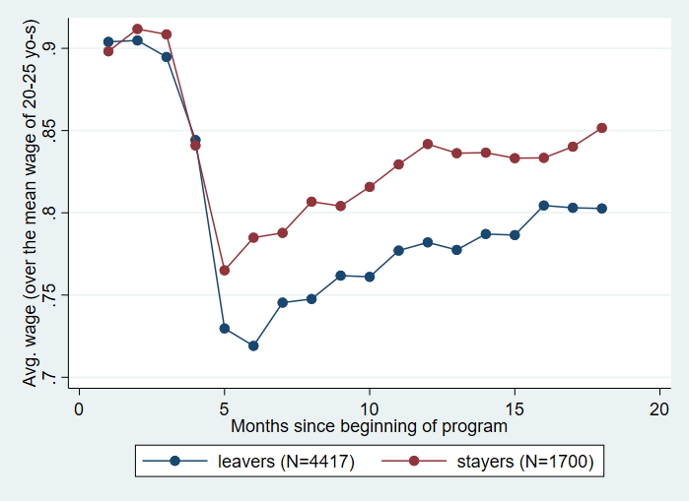
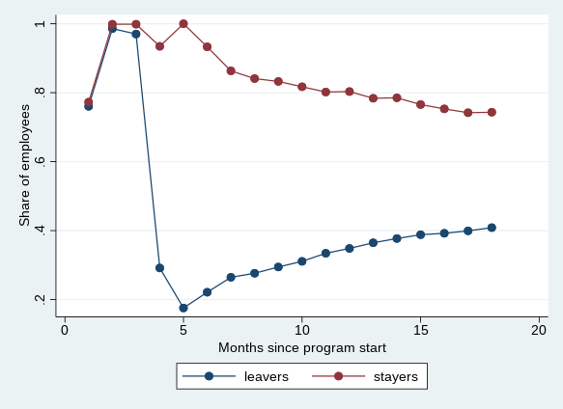
PARTICIPANTS STAYING AT THE FIRM HAVE BETTER OUTCOMES
Wage/average wage of 20-25 years old Employment rate

Slide 17
CONCLUSIONS
Clear sign of „cream skimming”: the programme does not reach those who need the help the most
Participation in job trial improves labour market outcomes 6 months after the programme compared to public works participants significantly , smaller difference compared to training participants
The impact weakens on the 12 months horizon
A potential explanation for cream skimming: better educated have better outcomes
but the impact of the programme is similar to lower educated

Slide 18
Thank you for your attention!
Budapest Institute for Policy Analysis
info@budapestistitute.eu

Slide 19
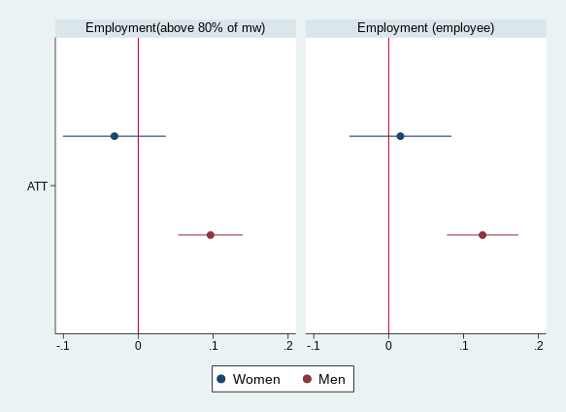
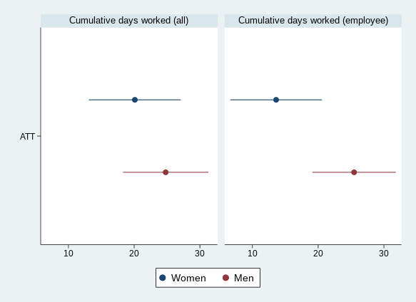
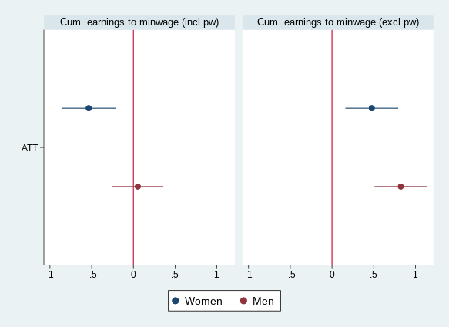
GENDER DIFFERENCES IN THE EFFECT OF THE JOB TRIAL
In contrast to the bulk of the literature,
(e.g. Bergemann and Bulk, 2006, Kluve,2017, Kluve,Card,Weber 2015, Lechner - Wiehler,2011)
the employment effect on females is weaker than on males compared to public works

Slide 20
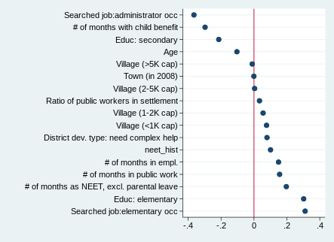
SELECTION OF FEMALES AND FERTILITY
What is behind the gender differences?
Selection of most employable unemployed is even stronger in case of women
Female paricipants are more educated, have shorter unemployment and NEET history, even without maternity leave than males
Maternity reduces the chance of participating in YG than in public work and training even after controlling for differences in all characteristics (except history )
↓
Main argument of the literature (women have more elastic labour supply as have more options and a greater distance to the labour market) does not hold
Standardized mean difference between male and female job trial pariticipants

Slide 21
SELECTION OF FEMALES AND FERTILITY
2) Programme participation does not reduce or postpone pregnancies
Explanation for stronger programme effect on women, e.g. in Lechner - Wiehler,2011)
Matching: participation doesn’t have an impact on the probability of being on maternity leave 12 months after the programme
Propensity score matching estimates for the parental status of young women, 12 months after the beginning of treatment

Slide 22
GENDER DIMENSION
Gender NEET gap in Hungary is one of the highest in Europe
Main factor behind gender gap : generous maternity leave (available until age 3 of the child)
Main question: does YG help young mothers to return to the labour market?
Motherhood and gender differences in selection into job trial
Gender differences in the effect of the job trial on outcomes

Slide 23
MATCHING RESULTS FOR 4 COUNTIES WITH NO SUBSEQUENT WAGE SUBSIDY

Slide 24
MATCHING RESULTS: 6 vs. 12 months

Slide 25
DOES JOB TRIAL PROMOTE LONG TERM WORK RELATIONS?
Some firms misuse the subsidy:
  of those who stay at the same workplace where received the subsidy, 12% work as a temporary worker and 8% as a public worker
Of those who employed 6 months after the programme, 45% works at the same firm where received the subsidy, 67% if including subsequent (8+4 month wage subsidy)
Who stays at the same firm?
  Best workers are enrolled into 8+4 month wage subsidy after the 90 day job trial
  Only treatment group: no difference between participants who stay at the same firm and work at another firm

Slide 26
COVARIATE BALANCE (CONTROL GROUP:PUBLIC WORKERS)
 | Mean |  |  | T-test
Variable | Treated | Control | %bias | t | p>|t|
working history, number of months
# of months in empl. | 14.464 | 10.464 | 28.9 | 14.3 | 0.000
# of months in empl. in last 2 years | 8.232 | 5.769 | 33.4 | 16.5 | 0.000
# of months as NEET, excl. parental leave | 12.200 | 14.169 | -13.3 | -6.5 | 0.000
# of months as NEET in last 2 years, excl. parental leave | 6.336 | 8.139 | -26.7 | -12.9 | 0.000
# of months with child benefit | 0.970 | 2.016 | -14.1 | -6.6 | 0.000
# of months with child benefit in last 2 years | 0.483 | 0.870 | -10.9 | -5.1 | 0.000
Received child related transfer ever | 0.032 | 0.062 | -14.1 | -6.6 | 0.000
Has a max 3 years old child | 0.012 | 0.021 | -7.2 | -3.4 | 0.001
Time since registry more than 12 months | 0.159 | 0.215 | -14.4 | -6.9 | 0.000
Time since registry less than 4 months | 0.625 | 0.507 | 24.0 | 11.6 | 0.000
Number of registry spells | 1.503 | 1.503 | 0.0 | 0.0 | 0.997
Education elementary | 0.282 | 0.487 | -43.1 | -20.7 | 0.000
Education secondary | 0.680 | 0.505 | 36.3 | 17.5 | 0.000
Education tertiary | 0.038 | 0.009 | 19.7 | 10.4 | 0.000
Number of observations | 3760 | 26631

Slide 27
RICH SET OF COVARIATES
Education
Labour market history:
  employment, unemployment, NEET history, public work, parental transfer
Geographical
  Type of settlement, development of the district, public employment service at the county seat, share of public workers in the settlement, distance of the settlement from the public employment service
Healthcare expenditures (drug consumption, inpatient and outpatient
Compared to public workers: occupation code (FEOR)
Competence test scores (available to a subsample)

Slide 28
DATA, OUTCOME VARIABLES
Data: Admin3 (CERS Databank)
Linked panel of administrative data, contains linked datasets of
  Public employment service (PES)
  Social security data
  Educational autority
  Firm tax database
  Individual level, random 50% sample of the population, 2003-2017
Data on program details, employment, wages, benefits from 2003
7 Outcome variables:
Work 6 and 12 months after completing the program
  Employee
  Any employment contract with wage exceeding 80% of the minimum wage
  Cumulative number of days in work after completing the program (all days, employee)
Cumulative wage to minimum wage, with and w/o public work

Slide 29
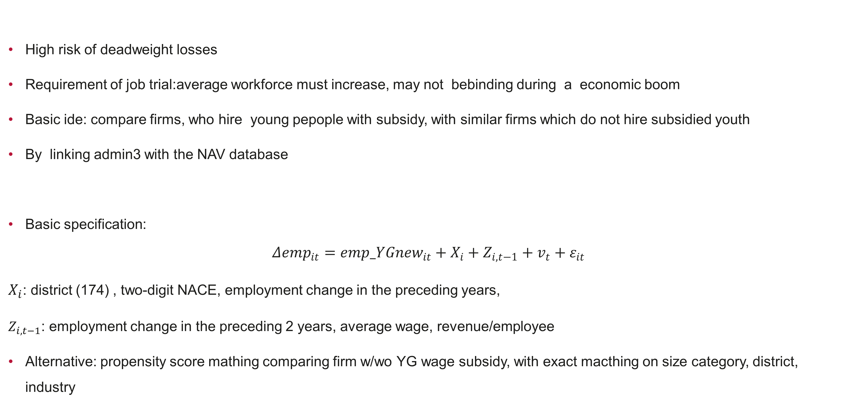
DEADWEIGTH LOSSES AND DISPLACEMENT
High risk of deadweight losses
Requirement of job trial:average workforce must increase, may not bebinding during a economic boom
Basic ide: compare firms, who hire young pepople with subsidy, with similar firms which do not hire subsidied youth
By linking admin3 with the NAV database
Basic specification:
$$Δ{emp}_{it}={emp_YGnew}_{it}+X_{i}+Z_{i,t−1}+v_{t}+ε_{it}$$
$X_{i}$: district (174) , two-digit NACE, employment change in the preceding years,
$Z_{i,t−1}$: employment change in the preceding 2 years, average wage, revenue/employee
Alternative: propensity score mathing comparing firm w/wo YG wage subsidy, with exact macthing on size category, district, industry

Slide 30
ESTIMATION OF DEADWEIGTH LOSSES

