Slide 1
Policy design and effects of Active Labor Market Programs for youths
Jochen Kluve
International Research Seminar,
Budapest, 12 May 2022

Slide 3
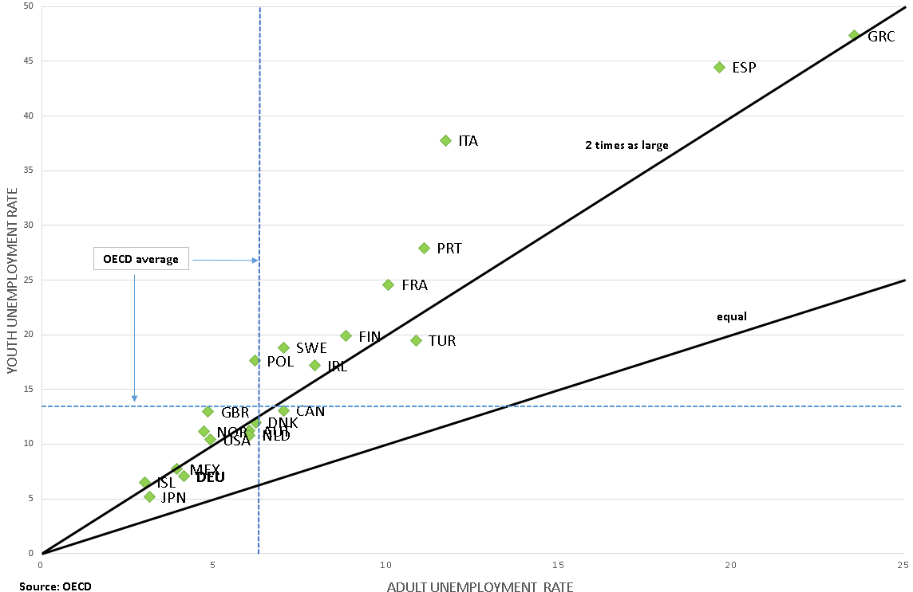
A persistent pattern: youth unemployment twice as high as adult unemployment
Source: OECD (2016)

Slide 4
Starting point
(Youth) Unemployment one of the most challenging economic / social problems in developed and developing countries
Exacerbated by the COVID-19 crisis and its very particular repercussions on the labor market
→ It is key for policymakers to find effective programs that help jobless find jobs, help workers-at-risk keep them, and help youths start a working career
Job training and other active labor market programs (ALMPs) have been promoted as a remedy for cyclical and structural unemployment
These programs have been in use at scale in many OECD countries since the ~1980s, and many experiences – including the Great Recession – have been made

Slide 5
Some key policy questions
What do we know about which type of “active” program works?
Short-run vs. long-run effects?
Do ALMPs work better for some groups? In some places or times? What about business cycle effects?
Are there any other aspects that are relevant for our discussion at this workshop?

Slide 6
Goals for this talk
A (very) basic framework for thinking about youth labor market interventions in general, and about how specifically ALMP actually work
Evidence on ALMP effectiveness: time horizon, youths, business cycle
Some additional stylized results I’ve found remarkable
Some conclusions

Slide 7
1) A (very) basic framework

Slide 8
Labor market interventions over the educational lifecycle
Labor market institutions and labor intermediation
Conditional Cash Transfers
Jóvenes type training prog.
Apprnt.
programs
Tailored:
Apprnt., trai-ning (SME), subsidies
Employment subsidy
On the job / vocational training,
other ALMPs
Skill deterioration,
unemployment
Transition
problems
Drop-out
Transition
problems
Vulnerability:
Absence
Drop-out
NEET
(key underlying
market failures:
-information failures
-skills mismatch
-lack of demand)
Availability / Teacher quality
Fin. Constr. / Availability
Primary
education
Secondary
education
Tertiary
education
Further labor
market career
School building programs
Teacher per-formance pay
Student loans, scholarships
Building programs, incentives
Framework conditions of the educational system

Slide 9
Types of active programs
Job Search Assistance -> job search efficiency
(Labour market) Training -> human capital accumulation, “classic”
Private sector employment incentives -> employer/worker behavior a) Wage subsidies, b) Self-employment assistance / start-up grants
Public sector employment -> direct job creation
Hybrid: short-time working arrangements (STWA) – version of (iii.)
Specific target groups: youths, older workers, long-term unemployed (LTU)
Main objective: raise participants’ employment / earnings

Slide 10
Alternative programs – summary
 | JSA | Training | Private sector incentives | Public employment
Government cost | Low | Medium / high | high | high
Short-run effect | Positive | Negative | Positive | (Positive)
Long-run effect (best case) | Small positive | (Large) Positive | Small positive | Zero
Long-run effect (worst case) | Small negative | Small negative | Negative | Large negative
Displacement | Medium | Low | High | High
Business cycle | Any time; expand in recession? | Any time; expand in recession | Any time; As STWA in recession | Recession

Slide 11
2) Evidence on ALMP effectiveness

Slide 12
How do we learn? The evidence base on ALMP effectiveness
Many reviews exist that cover ALMP experiences: Martin and Grubb (2001), Greenberg et al. (2003) OECD Employment Outlook (2015), McKenzie (2017), etc.
Focus here: ALMP evaluation database collected in Card Kluve Weber (2010) and Card Kluve Weber (2018), and extensions
Plus the systematic review of youth labor market interventions in Kluve, Puerto, Robalino et al. (2017/18)
Key ingredients: A few hundred Counterfactual Impact Evaluations (CIE) of ALMP interventions
This database is analyzed using meta-analytical methods
[Forthcoming: Meta analysis of ESF CIE database]

Slide 13
2a) Program effects by time horizon

Slide 14
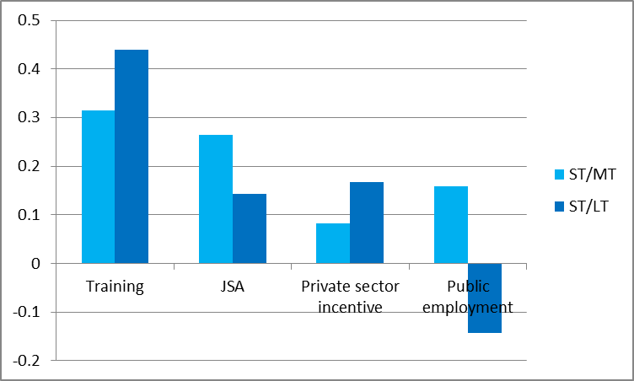
Time profile by program type: sign/significance switches
average of switches: +1 neg/insign or insign/pos,
0 unchanged, -1 reverse
ST: short-term, MT: medium-term, LT: long-term
Source: Meta-database compiled in Card, Kluve, Weber (2018)

Slide 15
Short-term ALMP effects and confidence intervals
Source: Card, Kluve, Weber (2018)

Slide 16
Medium-term ALMP effects and confidence intervals
Source: Card, Kluve, Weber (2018)

Slide 17
Long-term ALMP effects and confidence intervals
Source: Card, Kluve, Weber (2018)

Slide 18
2a) Summary of key ALMP patterns: time
ALMP effects increase with time after participation: in the longer run (>2 years afterwards) effects are larger in size and more likely to be positive
Time profile of impacts differs by program type:
  “work first" programs often have large short-term effects that fade out
  “human capital" programs often have small short-term effects with increasingly larger medium-/long-term effects
  The latter dynamic is also visible for “wage subsidy” programs, with somewhat smaller effect sizes
  “Public works” programs have, at best, small short-term effects that disappear or turn negative in the long run

Slide 19
2b) Program effects by target group:
youths

Slide 20
Effectiveness of youth interventions: outcomes
Source: Kluve, Puerto, Robalino et al. (2017)

Slide 21
Effectiveness of youth interventions: programs
Source: Kluve, Puerto, Robalino et al. (2017)

Slide 22
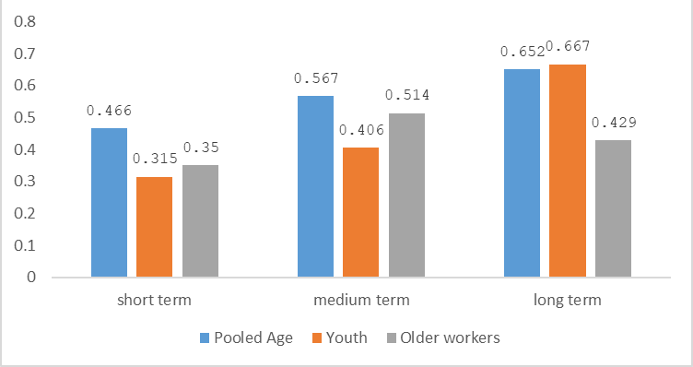
Probability of positive impact by time horizon and age group
Source: Extended ALMP Meta-database

Slide 23
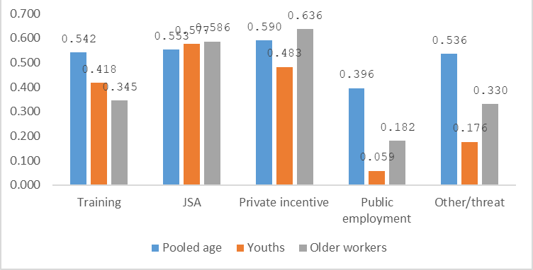
Probability of positive impact by ALMP and age group
Source: Extended ALMP Meta-database

Slide 24
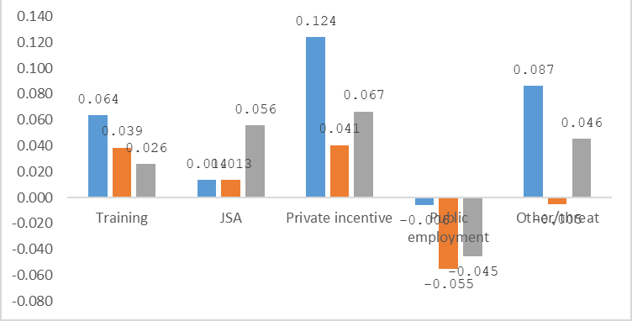
Size of estimated effect by ALMP and age group
Source: Extended ALMP Meta-database

Slide 25
2b) Summary of key ALMP patterns: youths
Youth ALMPs have a particularly pronounced time profile with increasing impacts in the longer run => this makes an ALMP investment towards youths particularly worthwhile, due to the longer payoff period
While effect sizes for youths are often small in size, the evidence shows that skills training, employment subsidies and JSA increase employment and earnings outcomes for youths

Slide 26
2c) Business cycle effects

Slide 27
Impacts of macro conditions on ALMP effectiveness: full sample

Slide 28
Impacts of macro conditions on ALMP effectiveness: DK, FR, DE, US sample

Slide 29
2c) Summary of key ALMP patterns: cycle
ALMPs have larger impacts in periods of slow growth and high unemployment
They seem to be particularly successful if participants are enrolled in a program during a downturn and exit the program during a period of favorable economic conditions
This could potentially match the way out of the Covid-19 crisis

Slide 30
3) Some additional stylized results

Slide 31
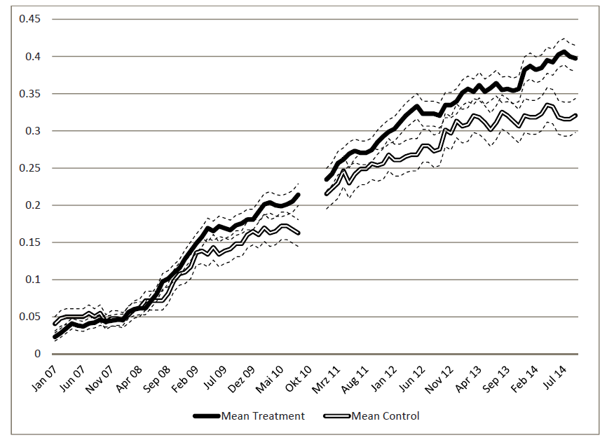
Long-term effect trajectory of a youth training program
  Point estimate 7 years after random assignment: 7.8 percentage points,
  26 per cent increase over the control mean
Formal employment rate – men, “Juventud y Empleo”, Dom. Rep.
Source: Ibarrarán et al. (2018)
31

Slide 32
Training duration: how long to invest for an ALMP training?
Source: Kluve, Schneider, Uhlendorff, Zhao (2012), Journal of the Royal Statistical Society

Slide 33
What about wage subsidies? The policy case remains strong
Rationale: to reduce – temporarily – the costs to employers of employing certain workers, thereby stimulating demand for these workers, raising their employment rates and earnings
Market failures the policy intends to address:
  skills mismatch
  information failures regarding vacancies and workers available
  lack of demand
Main mechanism: short-term employment can raise the productivity of the target group through their experience of work
Subsidies compensate employers for the risk of taking a chance in hiring such workers

Slide 34
Key concerns
In general, only a short-run impact can be expected unless the subsidized employment changes individuals’ preferences for work and/or their productivity and future employability
“General equilibrium effects”:
  Crowding-out: program creates jobs at expense of jobs in other sectors
  Substitution: jobs created replace other workers
  Deadweight: subsidized hirings would have also occurred in absence of program

Slide 35
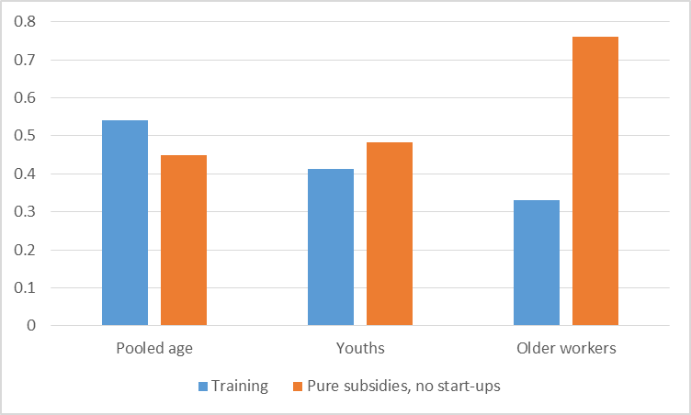
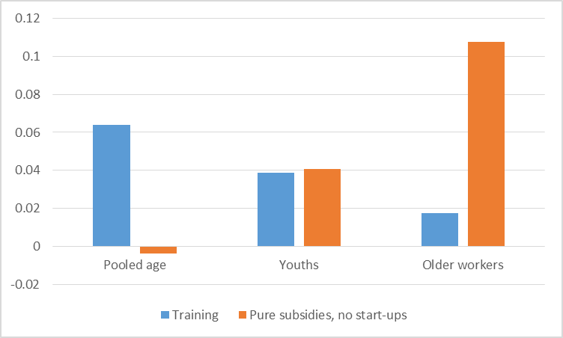
Employment subsidies work for youths, but in worldwide evidence older workers seem to benefit more strongly
Share with positive effect
Effect size
Source: Authors‘ elaboration using data from Card, Kluve, Weber (2018).
The first graph shows the average probability of a positive impact on employment or earnings for programs by participant group – age.
The second graph shows the average effect size on participants‘ employment probability by participant group – age.

Slide 36
Employment subsidies: key design challenges
Challenge 1
Challenge 2
Source: Groh et al. (2016), Subsidy pilot program, Jordan

Slide 37
4) Some conclusions

Slide 38
Key takeaways
ALMP in general are no panacea: structural deficits in the educational system, welfare system etc. need to be tackled elsewhere
Skills training and subsidies can be successful for youths, hence it is worth focusing on this group
Additional rationale: much longer pay-off period, avoiding “scarring effects”
And: early intervention is better than late intervention
“Youth Guarantee” ideas are the right starting point
Consider bundling programs, in particular linking hiring incentives to upskilling components

Slide 39
Thank you.
jochen.kluve@kfw.de

Slide 40
Appendix

Slide 41
How do ALMPs work?
-> Job search assistance (JSA)
Purpose: Raise search effort / efficiency of search + job match
Components: Job search training, Counseling, Monitoring, + Sanctions
Nudge procrastinators
Implications:
Only a short-run effect unless getting a job changes preferences or future employability (job ladder effect)
Risk of displacement effect (esp. in low-demand market)
May have important role in addressing information failures in rapidly changing environment => link to COVID-19

Slide 42
How do ALMPs work?
-> Training and Re-training
Purpose: Raise human capital (HC)
Attenuate skills mismatch
Training components: 1) Classroom vocational / technical training, 2) work practice (on-the-job training), 3) Basic skills training (math, language), 4) life skills training (socio-affective, non-cognitive skills)
Implications:
Training takes time -> negative effects in short-run
But positive (and large?) long-run effect
Negative effect if training obsolete / useless
Limited displacement effect

Slide 43
How do ALMPs work?
-> Private sector employment incentives
Purpose: improve job matching process; increase (or maintain) labour demand
Limited human capital accumulation through work practice
Culturisation
Implications:
Only a short-run effect unless work changes preferences or future employability
High risk of displacement effect
May play an important role as STWA in recession

Slide 44
How do ALMPs work?
-> Public sector employment
Purpose: Prevent human capital deterioration; increase labour demand (?)
Safety net (of last resort)
Implications:
Only a short-run effect (on public employment) unless work changes preferences or future employability
High risk of displacement effect
Or: Type of jobs often not close to the labour market

